Slide 1
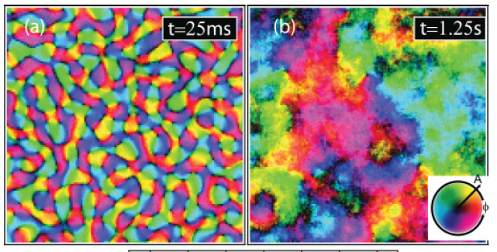
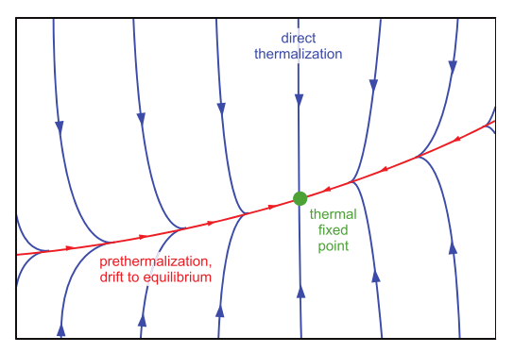
Coarsening dynamics
Harry Cheung
2 Nov 2017

Slide 2
Outline
Non equilibrium physics
Infinite relaxation time for infinite system
Breaking fluctuation dissipation relation
Renormalization group treatment
Coarsening in isolated quantum system
Non-thermal fixed point
Self similar evolution

Slide 3
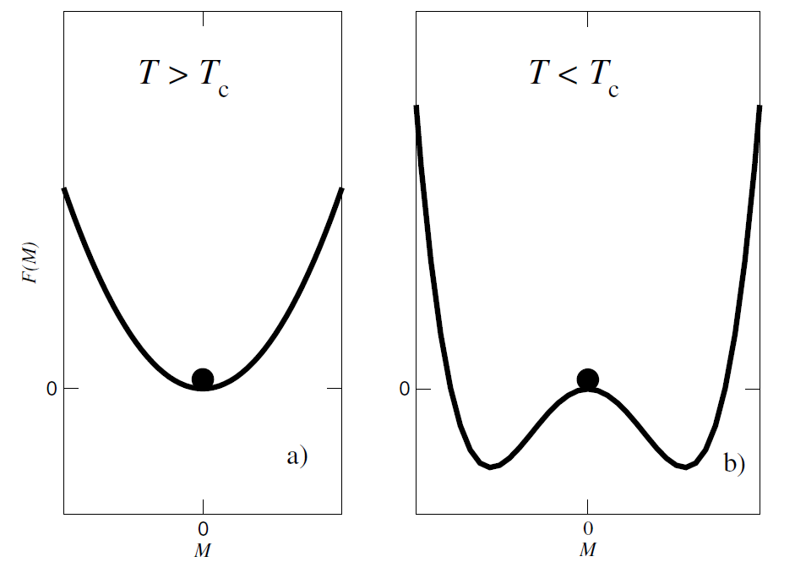
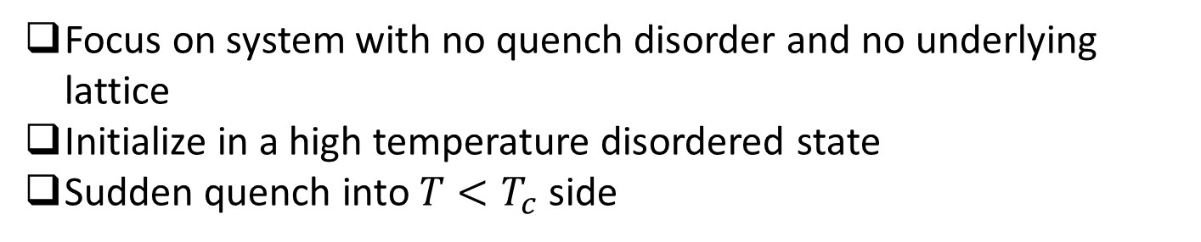
Coarsening
Focus on system with no quench disorder and no underlying lattice
Initialize in a high temperature disordered state
Sudden quench into $T<T_{c}$ side
Fluctuation induced initial growth

Slide 4
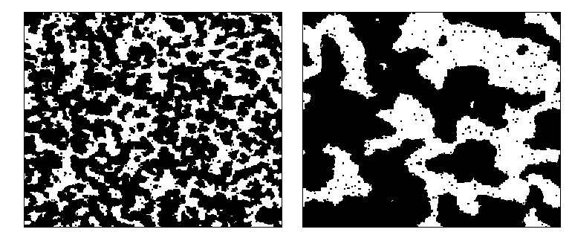
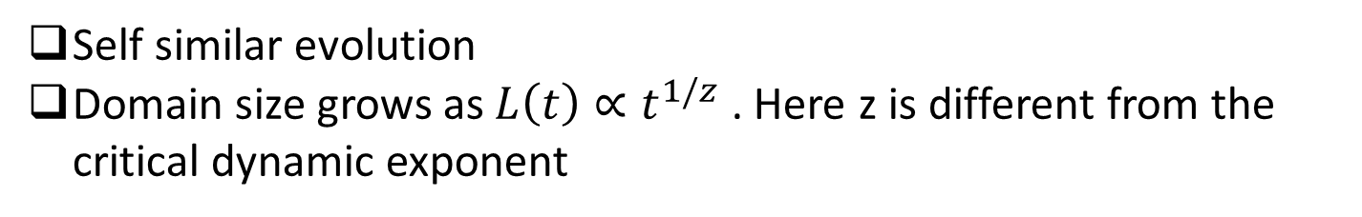
Coarsening – Ising Monte Carlo simulation
Time
Henkel et. al., Non-Equilibrium Phase Transitions Vol 2
Self similar evolution
Domain size grows as $L\left(t\right)∝t^{1/z}$ . Here z is different from the critical dynamic exponent

Slide 5

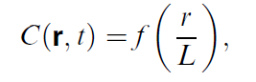
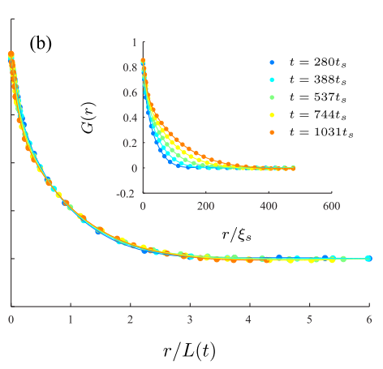
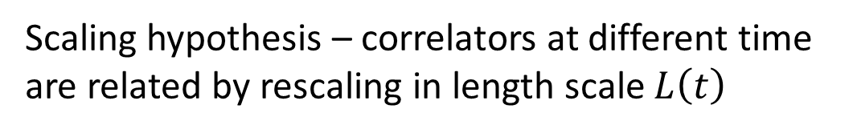
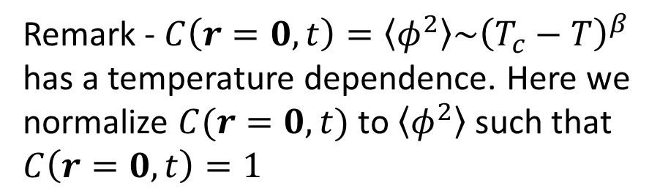
Late time dynamics – scaling hypothesis
Equal time correlator
Scaling hypothesis – correlators at different time are related by rescaling in length scale $L\left(t\right)$
Williamson et. al. arXiv 1703.09360
Williamson et. al. PRA 94, 023608 (2016)
Remark - $C\left(r=0,t\right)=\left\langle φ^{2}\right\rangle \sim {\left(T_{c}−T\right)}^{β}$ has a temperature dependence. Here we normalize $C(r=0,t)$ to $\left\langle φ^{2}\right\rangle$ such that $C\left(r=0,t\right)=1$

Slide 6
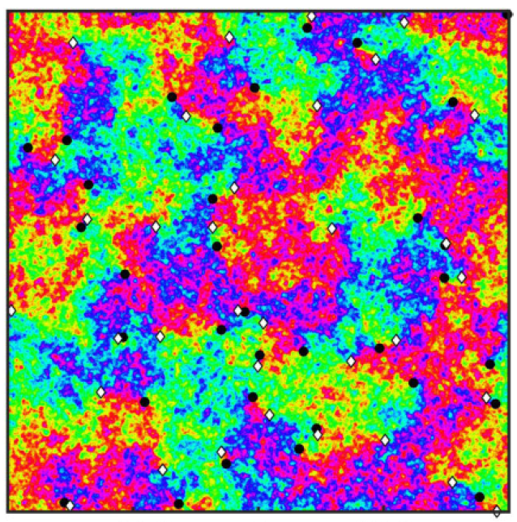
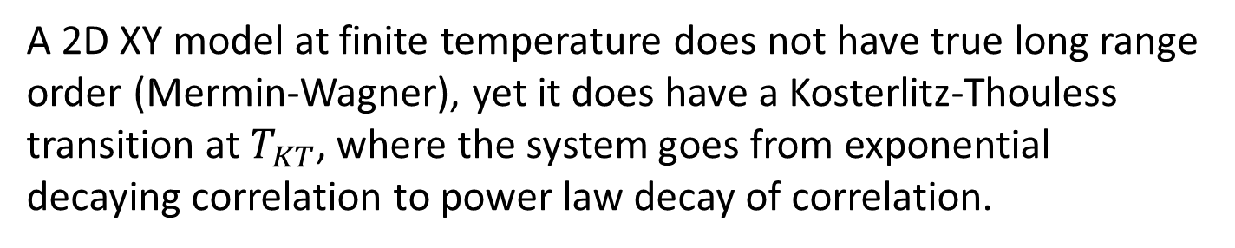

Scaling hypothesis – algebraic order
A 2D XY model at finite temperature does not have true long range order (Mermin-Wagner), yet it does have a Kosterlitz-Thouless transition at $T_{KT}$, where the system goes from exponential decaying correlation to power law decay of correlation.
If there is only algebraic order instead of power law order, then the scaling hypothesis needs to be modified
$$C\left(r,t\right)=r^{−η}f(\frac{r}{L\left(t\right)})$$

Slide 7
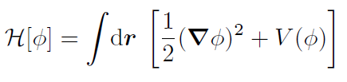


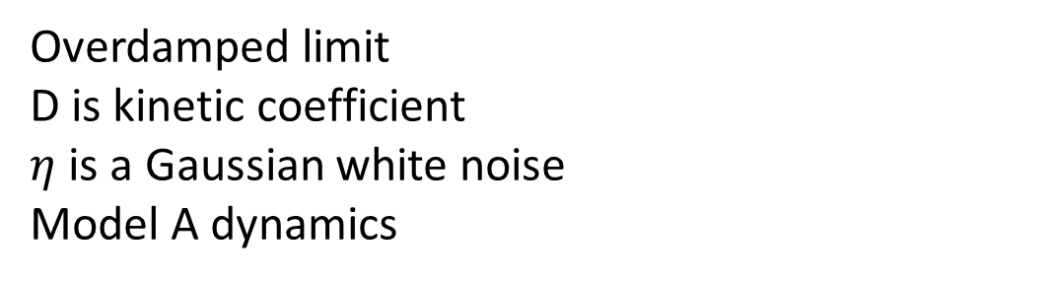
Ising model – coarsening without conservation law
Ginzburg-Landau functional
Double well potential
Stochastic Langevin equation
A. J. Bray (2002): Theory of phase-ordering kinetics, Advances in Physics, 51:2, 481-587
Overdamped limit
D is kinetic coefficient
$η$ is a Gaussian white noise
Model A dynamics
P. C. Hohenberg and B. I. Halperin Rev. Mod. Phys. 49, 435

Slide 8
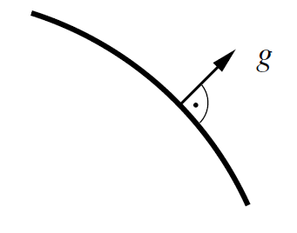




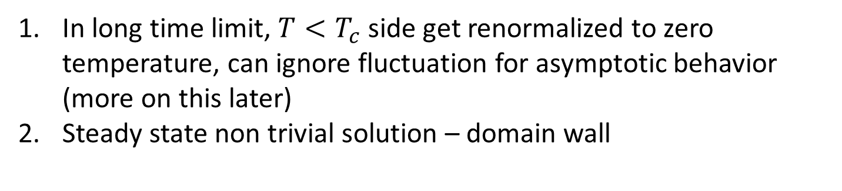
Solving Ising model without conservation
In long time limit, $T<T_{c}$ side get renormalized to zero temperature, can ignore fluctuation for asymptotic behavior (more on this later)
Steady state non trivial solution – domain wall
Normal coordinate g across domain wall.
Steady state solution implies
Away from domain wall, order parameter has asymptotic form

Slide 9
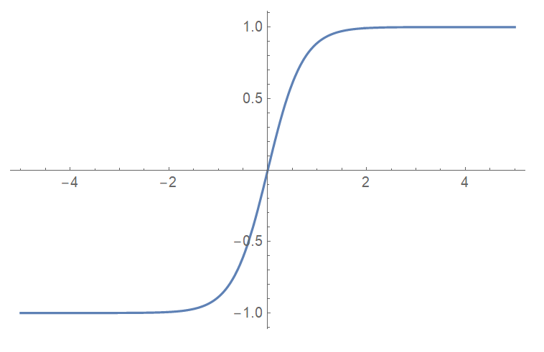
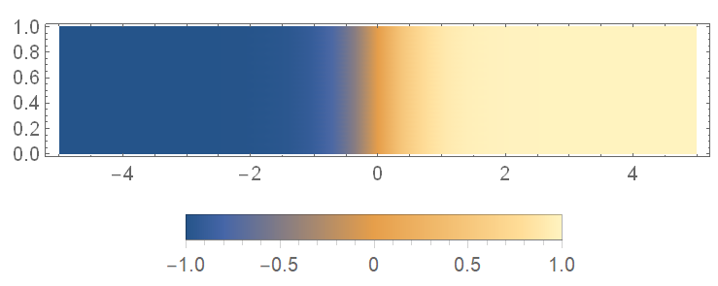
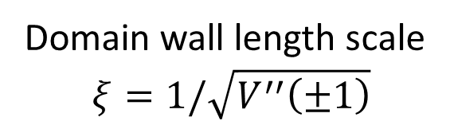
Solving Ising model without conservation – domain wall
Domain wall length scale
$$ξ=1/\sqrt{V^{′′}\left(±1\right)}$$

Slide 10
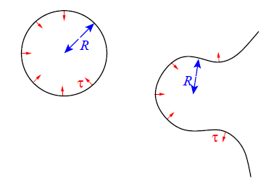
Domain wall evolution
Flat domain wall is stable, but a curved domain wall will move under surface tension.
EOPC 11.4.1

Slide 11






Evolution of domain wall - Allen-Cahn equation
Initial distribution of the form of spherical domain
Space coarsened equation, with length scale larger than domain wall size
Multiply with $f′$ and integrate
$$z=2$$

Slide 12
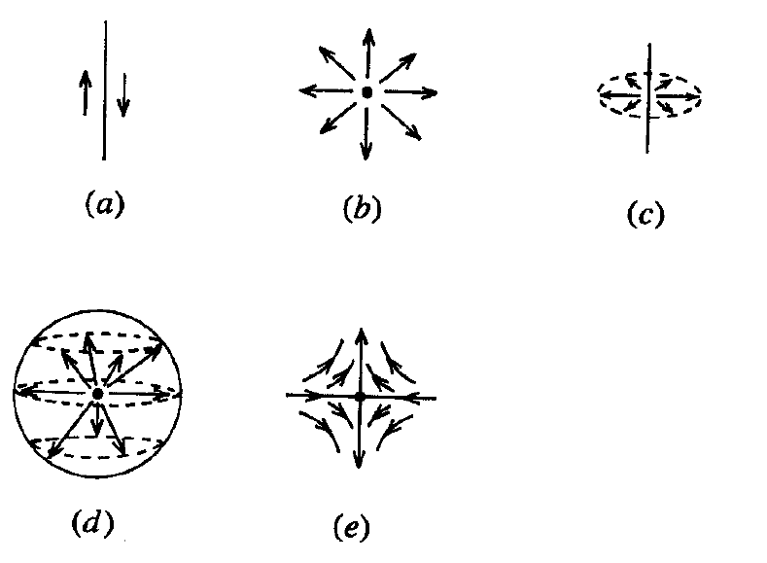
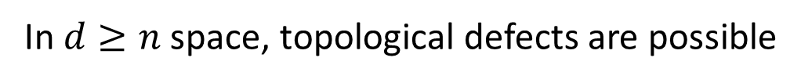
Topological defects
In $d≥n$ space, topological defects are possible
Domain wall (n=1)
Vortex (d=2=n)
Vortex string (d=3, n=2)
Monopole (d=3=n)
Anti-vortex (d=2=n)

Slide 13
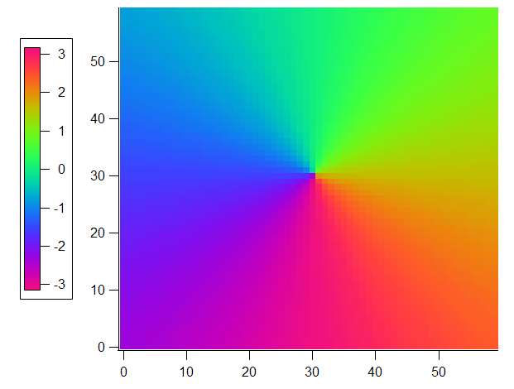




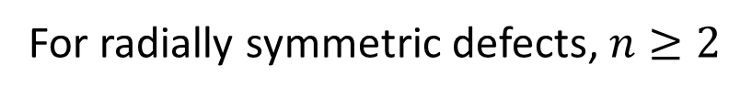
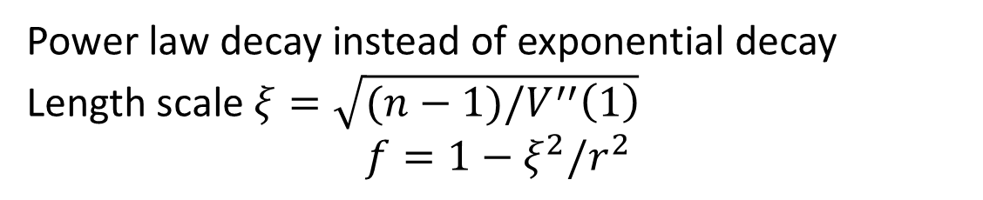
Topological defects – functional form
For radially symmetric defects, $n≥2$
Steady state solution
Boundary condition $f\left(0\right)=0,f\left(∞\right)=1$
At large r, the asymptotic form of f is given by
Power law decay instead of exponential decay
Length scale $ξ=\sqrt{(n−1)/V^{′′}\left(1\right)}$
$$f=1−ξ^{2}/r^{2}$$

Slide 14
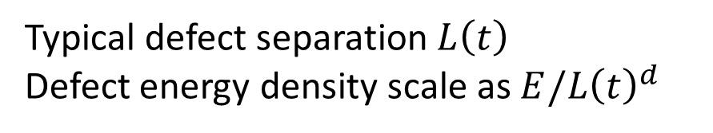
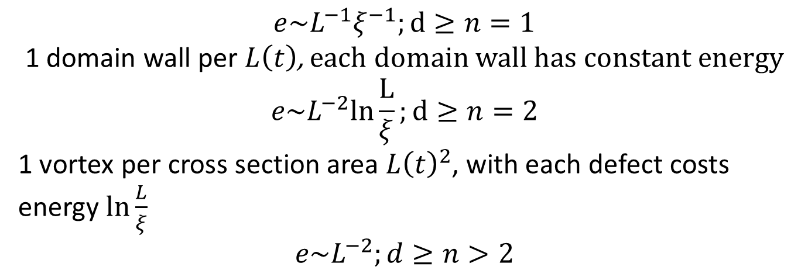
Topological defects - energy
Typical defect separation $L\left(t\right)$
Defect energy density scale as $E/L{\left(t\right)}^{d}$
$$e\sim L^{−1}ξ^{−1};d≥n=1$$
1 domain wall per $L\left(t\right)$, each domain wall has constant energy
$$e\sim L^{−2}ln\frac{L}{ξ};d≥n=2$$
1 vortex per cross section area $L{\left(t\right)}^{2}$, with each defect costs energy $\ln{\frac{L}{ξ}}$
$$e\sim L^{−2};d≥n>2$$

Slide 15
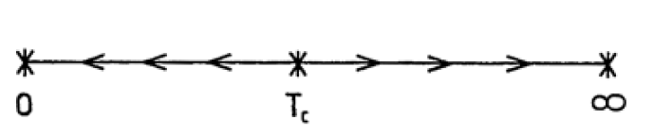
Irrelevance of fluctuation
Previously argue that temperature is irrelevant for coarsening.
A heuristic RG argument shows that temperature is rescaled to zero after spatial-temporal coarse graining
Original quench
Rescaled quench

Slide 16


Irrelevance of fluctuation – more detailed RG
Evolution with conserved order parameter
Fluctuation dissipation relation gives us the noise correlator
Here we assume the mean field free energy landscape and temperature can be tuned independently

Slide 17

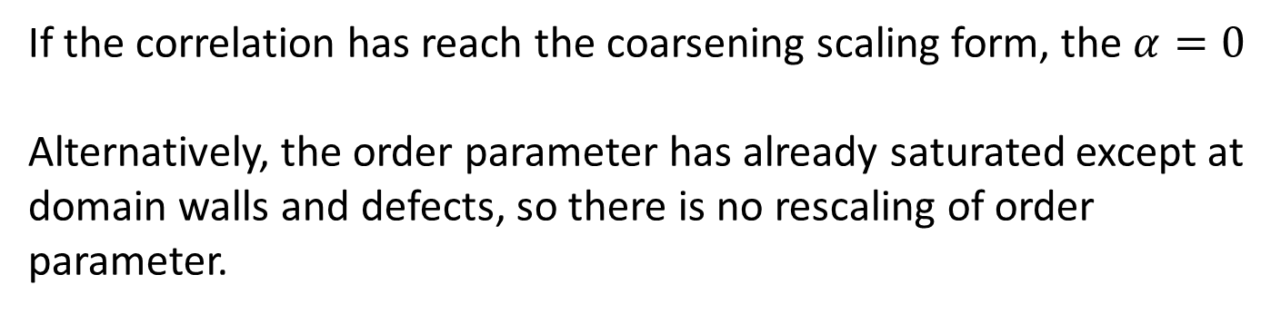
Irrelevance of fluctuation – more detailed RG
Rescale time, space and order parameter
$$r=b r′, t=b^{z}t′$$
Correlator rescaled as
If the correlation has reach the coarsening scaling form, the $α=0$
Alternatively, the order parameter has already saturated except at domain walls and defects, so there is no rescaling of order parameter.

Slide 18
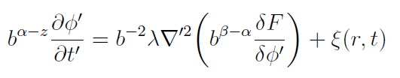


Irrelevance of fluctuation – more detailed RG
Rescale free energy, $F→b^{β}F$ and rescale equation
Define new noise
The equation of motion in terms of new variables is
With noise correlator

Slide 19
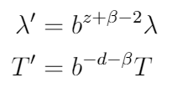
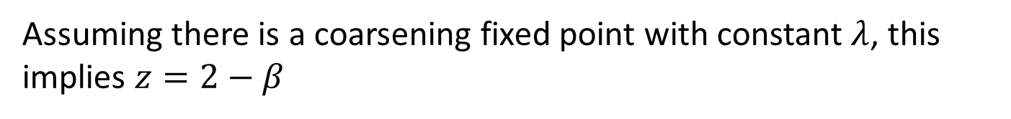
Irrelevance of fluctuation – more detailed RG
This is equivalent to rescaling of parameters
Assuming there is a coarsening fixed point with constant $λ$, this implies $z=2−β$

Slide 20
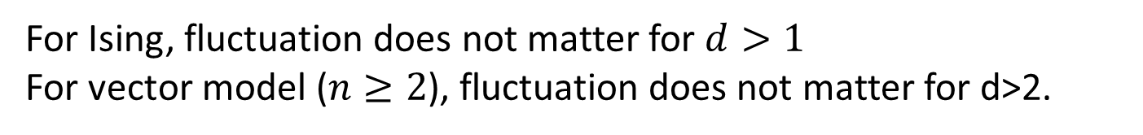
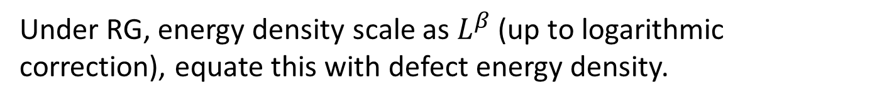
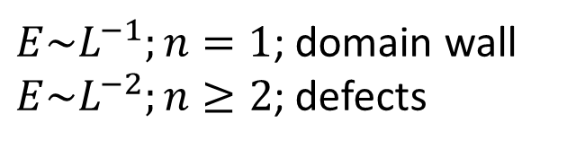
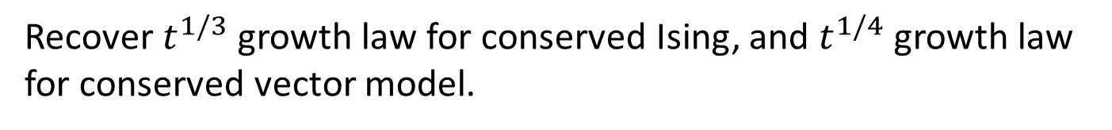
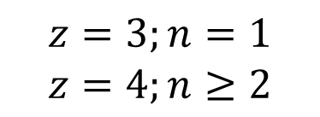

Prediction of dynamic exponent z – RG
Under RG, energy density scale as $L^{β}$ (up to logarithmic correction), equate this with defect energy density.
$E\sim L^{−1};n=1$; domain wall
$E\sim L^{−2};n≥2$; defects
$$β=−1;d+β=d−1;n=1$$
$$β=−2;d+β=d−2;n≥2$$
For Ising, fluctuation does not matter for $d>1$
For vector model ($n≥2$), fluctuation does not matter for d>2.
$$z=3;n=1$$
$$z=4;n≥2$$
Recover $t^{1/3}$ growth law for conserved Ising, and $t^{1/4}$ growth law for conserved vector model.

Slide 21
Summary of dynamical exponent z
With no conservation law - z=2
Ising with conservation law – z=3
Vector order parameter with conservation – z=4

Slide 22
Coarsening in isolated quantum system
So far coarsening is treated in the classical case, where there is source of external noise, and the system follows dissipative evolution.
How does an isolated quantum system coarsen? Can it be mapped onto classical dynamic universality class?

Slide 23
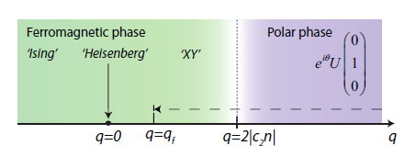
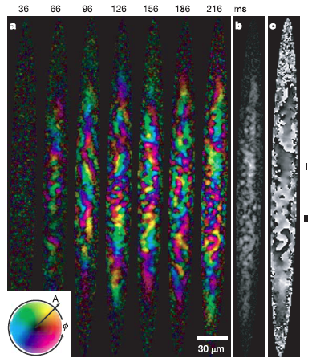
Coarsening in isolated quantum system
F=1 spinor system – quench from polar to ferromagnetic XY phase
Experiment
Simulation
R. Barnett et. al., PRA 84, 023606 (2011)
L.E. Sadler et. al., Nature ,443, 164 (2006)

Slide 24
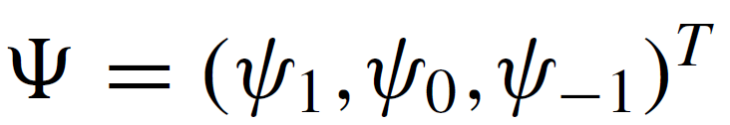


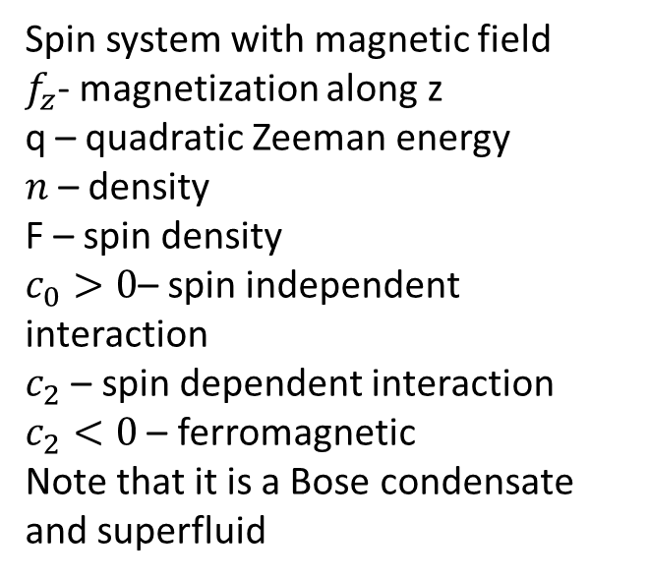
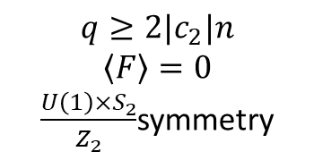
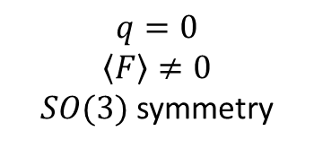
Coarsening in F=1 spinor condensate
Hamiltonian
T=0 phase diagram
$$q=0$$
$$\left\langle F\right\rangle ≠0$$
$SO(3)$ symmetry
$$q≥2|c_{2}|n$$
$$\left\langle F\right\rangle =0$$
$\frac{{U\left(1\right)×S}_{2}}{Z_{2}}$symmetry
Spin system with magnetic field
$f_{z}$- magnetization along z
q – quadratic Zeeman energy
$n$– density
F – spin density
$c_{0}>0$– spin independent interaction
$c_{2}$ – spin dependent interaction
$c_{2}<0$ – ferromagnetic
Note that it is a Bose condensate and superfluid
R. Barnett et. al., PRA 84, 023606 (2011)
Y. Kawaguchi, M. Ueda Physics Reports 520 (2012) 253–381

Slide 25
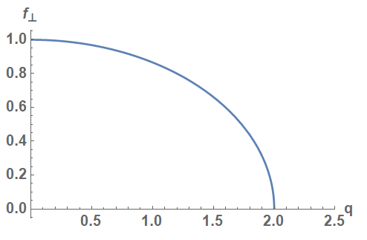
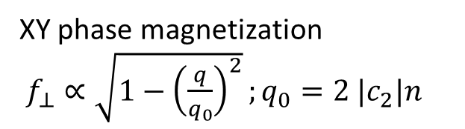
Mean field phase diagram
XY phase magnetization
$f_{⊥}∝\sqrt{1−{\left(\frac{q}{q_{0}}\right)}^{2}};q_{0}=2 |c_{2}|n$
Near $q=2|c_{2}|n$, this can be mapped to an O(2) model
A. Lamacraft, PRL 98, 160404 (2007)

Slide 26
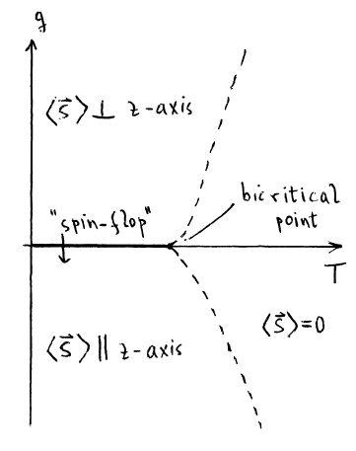
Mean field phase diagram
Spin flip from purely in XY plane to along z when q crosses 0
Koln et. al. Critical Phenomena

Slide 27
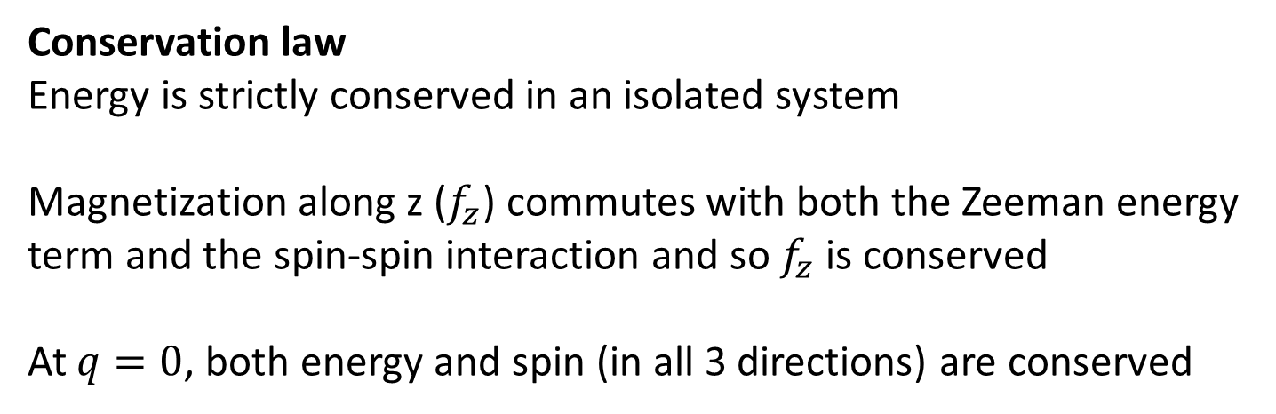
Mean field phase diagram
Conservation law
Energy is strictly conserved in an isolated system
Magnetization along z ($f_{z}$) commutes with both the Zeeman energy term and the spin-spin interaction and so $f_{z}$ is conserved
At $q=0$, both energy and spin (in all 3 directions) are conserved

Slide 28
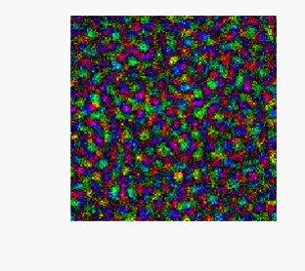
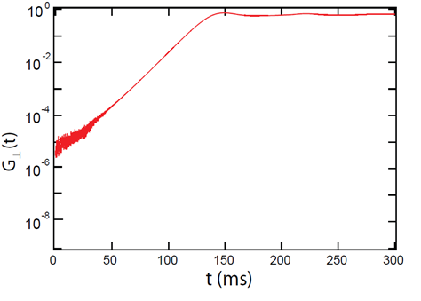

Evolution after quench
Coarsening
Initial growth
R. Barnett et. al. Phys. Rev. A 84, 023606
$$G_{⊥}\left(r\right)≡Transverse Magnetization$$

Slide 29
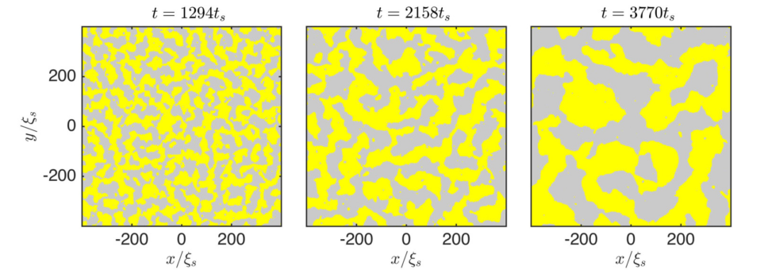



Coarsening into Ising phase, F=1 spinor in d=2 (Simulation)
Williamson et. al. arXiv 1703.09360
Williamson et. al. PRA 94, 023608 (2016)
Correlator in $f_{z}$
extracted 1/z=0.67

Slide 30



Coarsening into XY phase, F=1 spinor in d=2 (Simulation)
Williamson et. al. arXiv 1703.09360
Williamson et. al. PRA 94, 023608 (2016)
Correlator in $f_{⊥}$
extracted 1/z=1
With log correction

Slide 31



Coarsening into Heisenberg phase, F=1 spinor in d=2 (Simulation)
Williamson et. al. arXiv 1703.09360
Williamson et. al. PRA 94, 023608 (2016)
Correlator in $F$
extracted 1/z=1/2

Slide 32





Crossover behavior
$$f_{z}$$
Ising
$$f_{⊥}$$
$$f_{⊥}$$
XY
Williamson et. al. PRA 94, 023608 (2016)
$$f_{z}$$
Coarsening into regime very close to Heisenberg spin will in general reveal crossover behavior. With short time coarsening reminiscent of Heisenberg coarsening, but revert to Ising or XY scaling at long time.

Slide 33


Coarsening, F=1 spinor in d=2
Expectation based on conservation law
Extracted z
The dynamic exponents z are different from the ones obtained from order parameter dimension and conservation law alone.

Slide 34
Coarsening, F=1 spinor in d=2
Why would a quantum model without dissipation have the same coarsening behavior as a classical dissipative model?
How can we understand these exponents?

Slide 35


Coarsening, F=1 spinor in d=2 – Ising phase
The system is a superfluid and the order parameter $f_{z}$ is coupled to superfluid velocity
Hydrodynamic transport of order parameter
EOPC 11.4.1

Slide 36









Coarsening, F=1 spinor in d=2 – Ising
Hydrodynamic equation
Spin current
Continuity equation of $F_{z}$
Equation of motion
Differential pressure is proportional to surface tension times curvature
$$ΔP\sim F_{z}^{2}\sim \frac{σ}{R}$$
Rescale $t→\frac{t}{T}, r→r/L(T)$
Note $ΔP$ scale as L, and so $∇P$ scale as $L^{2}$
Scaling hypothesis implies that $L\sim T^{2/3}$
Williamson et. al. PRA 94, 023608 (2016)

Slide 37
Non-thermal fixed point
Wetterich C 2012 Prethermalization (talk given at RETUNE, Heidelberg)
Dynamical fixed point from dynamical system theory
Rapid approach to prethermal state/non-thermal fixed point, followed by approach to thermal state at large or infinite time

Slide 38


Non-thermal fixed point
P. Orioli et. al. PRD 92, 025041.
Self similar evolution of mode occupancies $f(t,p)$
Inverse cascade – particle flows to low momentum, energy flows to high momentum

Slide 39




Non-thermal fixed point
Nonlinear Schrodinger equation
Total particle number
Conservation of particle number (in low momentum) implies $α=dβ$
Universal collapse in d=3 with
$$α=\frac{3}{2},β=\frac{1}{2}$$

Slide 40
Summary
Coarsening rate depends on order parameter dimension, conserved quantities and other modes that couples to order parameter
Coarsening can happen in an isolated quantum system with no dissipation. Furthermore, this could be mapped onto classical dynamic universality classes (for some quantum systems)
Non thermal fixed point is alternative way to interpret coarsening in isolated quantum system

